Slide 1
IHS
Summer Reading

Slide 2
Welcome, Bucs!
All Honors and AP Students will have an additional required book and assignment to complete.
This summer, all Interboro High School students are expected to select one novel from their curated grade level list and answer the guided questions as they read.
Parents are encouraged to help their children select books based on genre, topic, and age-level appropriateness. Please take some time together to review the recommendations to ensure your child's interests and reading ability is met by their choice. We suggest using Common Sense Media to review any selections beyond the information provided here.
If you have any questions, you can reach out to the English Department Curriculum Coordinator, Noelle Ackland at noelle.ackland@interborosd.org.
We hope that by offering selections to match a wide range of student interest, our Bucs will continue developing their critical thinking skills, and enjoy the process of losing themselves in a good book!

Slide 3
Ninth Grade Options
*Click here for guided questions!

Slide 4
Honors English 9
The Glass Castle is a remarkable memoir of resilience and redemption, and a revelatory look into a family at once deeply dysfunctional and uniquely vibrant.
The Walls children learned to take care of themselves. They fed, clothed, and protected one another, and eventually found their way to New York. Their parents followed them, choosing to be homeless even as their children prospered.
The Glass Castle is truly astonishing—a memoir permeated by the intense love of a peculiar but loyal family.
Click here to access the accompanying assignment!

Slide 5
Tenth Grade Options
*Click here for guided questions!

Slide 6
Honors English 10
Meet the Ganguli family, new arrivals from Calcutta, trying their best to become Americans even as they pine for home. The name they bestow on their firstborn, Gogol, betrays all the conflicts of honoring tradition in a new world — conflicts that will haunt Gogol on his own winding path through divided loyalties, comic detours, and wrenching love affairs.
Click here to access the accompanying assignment!
*A limited number of copies may be signed out - see Ms. Crothers in Room 223 if you would like to take one home this summer!

Slide 7
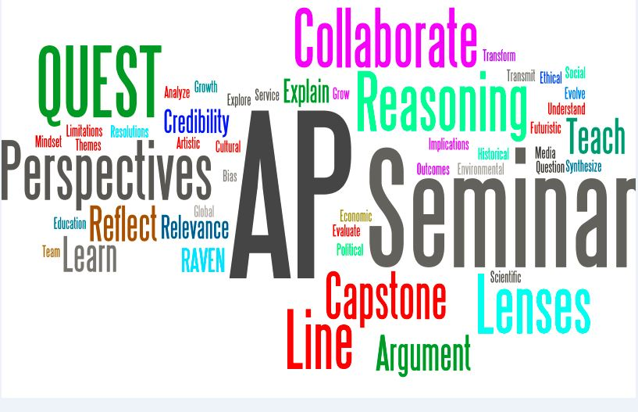
AP Seminar
Click here to access more information about AP Seminar Summer Work!
We are so excited that you enrolled in this course. This is the first year AP Seminar is being taught at Interboro High School, and we are excited to see how this program will grow in the coming years and prepare you for future AP work and college classes. This class will likely be unlike any class you have taken before, and we are going to have a wonderful experience learning with one another.
Please join the AP Seminar Summer Group: J5GX-BW3M-4B8M8

Slide 8
Eleventh Grade Options
*Click here for guided questions!
*A limited number of copies of ANTHEM may be signed out - see Mr. Pattinson in Room 225 if you would like to take one home this summer!

Slide 9
Honors English 11
Vietnam veteran John Wade is running for senate when long-hidden secrets about his involvement in wartime atrocities come to light. But the loss of his political fortunes is only the beginning of John’s downfall. A retreat with his wife, Kathy, to a lakeside cabin in northern Minnesota only exacerbates the tensions rising between them. Then, within days of their arrival, Kathy mysteriously vanishes into the watery wilderness.
When a police search fails to locate her, suspicion falls on the disgraced politician with a violent past. But when John himself disappears, the questions mount—with no answers in sight. In this contemplative thriller, acclaimed author Tim O’Brien examines America’s legacy of violence and warfare and its lasting impact both at home and abroad.
Click here to access the accompanying assignment!
*A limited number of copies may be signed out - see Mr. Foltz in Room 212 if you would like to take one home this summer!

Slide 10
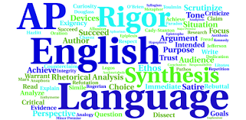
AP Language
Please join the AP Language Summer Group: 3M3F-J644-WH87M
Click here to access more information about AP Language Summer Work!

Slide 11
Twelfth Grade Options
*Click here for guided questions!

Slide 12
Honors English 12
One of Esquire's 50 Best Sci-Fi Books of All Time
“A brilliant novel.… [A] savage satire on the distortions of the single and collective minds.”―New York Times
In Anthony Burgess’s influential nightmare vision of the future, where the criminals take over after dark, the story is told by the central character, Alex, a teen who talks in a fantastically inventive slang that evocatively renders his and his friends’ intense reaction against their society. Dazzling and transgressive, A Clockwork Orange is a frightening fable about good and evil and the meaning of human freedom.
Click here to access the accompanying assignment!

Slide 13
AP Literature
The Stranger continues to be a thought-provoking exploration of existential themes, prompting discussions about the nature of morality, the search for meaning, and the consequences of individual choices. The novel’s impact extends beyond literature, influencing philosophical discourse, psychology, and the broader understanding of the human experience.
Click here to access more information about AP Lit Summer Work!
*A limited number of copies may be signed out - see Mrs. Ackland in Room 211 if you would like to take one home this summer!

Slide 14
Happy Reading!
See you in September, Bucs!

